Slide 1
Interactive Dashboard for Data Visualization
Using Streamlit and Python
Ishit Singh
Puru Singh
Pratyush Pandey

Slide 2
Libraries and Languages used:
Python Programming Language
Pandas Library
Numpy Library
Plotly Library

Slide 3
Methodology:
Taking a CSV file as input from the user.
Reading the CSV file for data extraction.
Selection of Columns from a dropdown menu for graph plot.
Plotting the graph as Column x Column.
Displaying the graph.
Showing RAW Data.

Slide 4
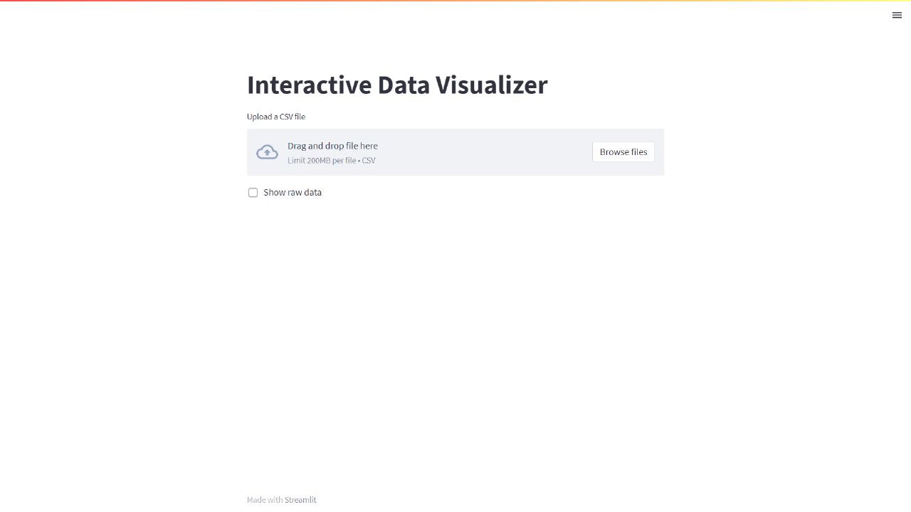
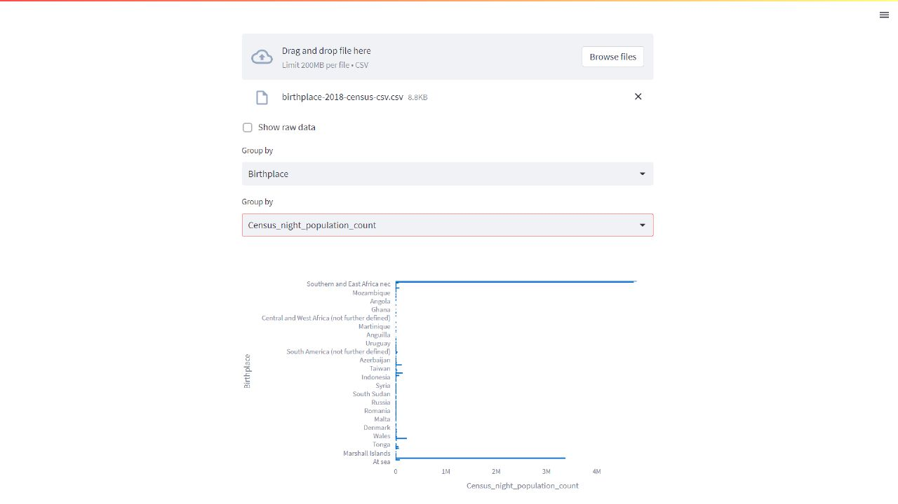
Sample Outputs

Slide 5
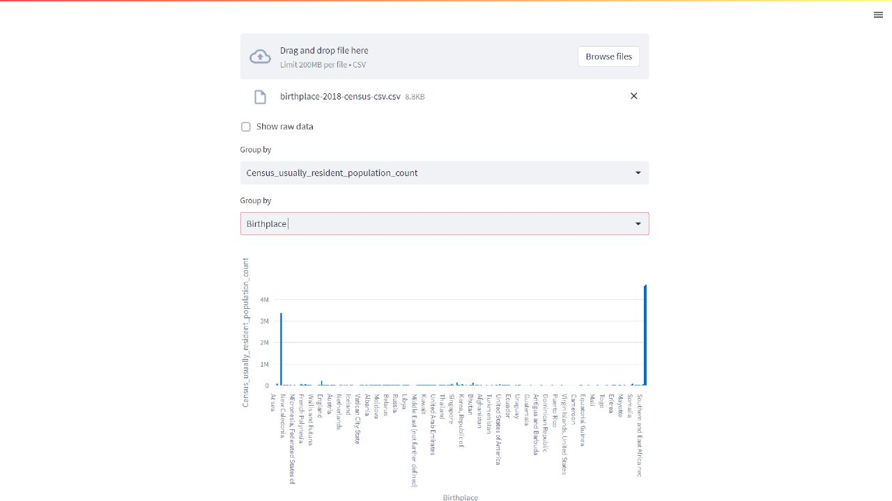
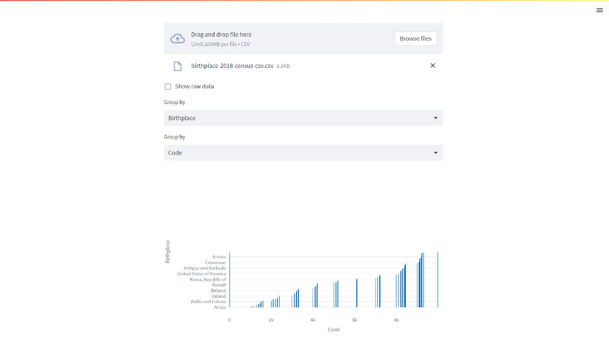
Sample Outputs:

Slide 6
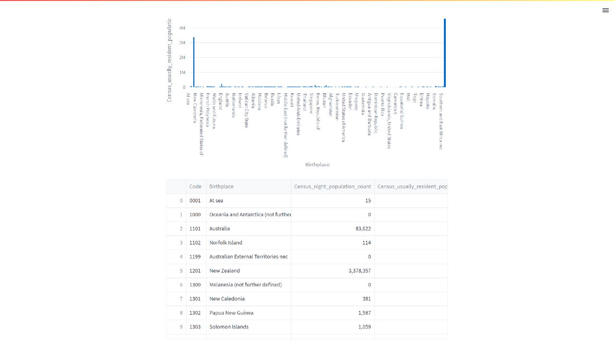
Sample Outputs:

Slide 7
Conclusion:
Data has been Visualized from the CSV file received as input.

Slide 8
Thank you!
Presentation by:
Ishit Singh
Puru Singh
Pratyush Pandey

